Slide 1
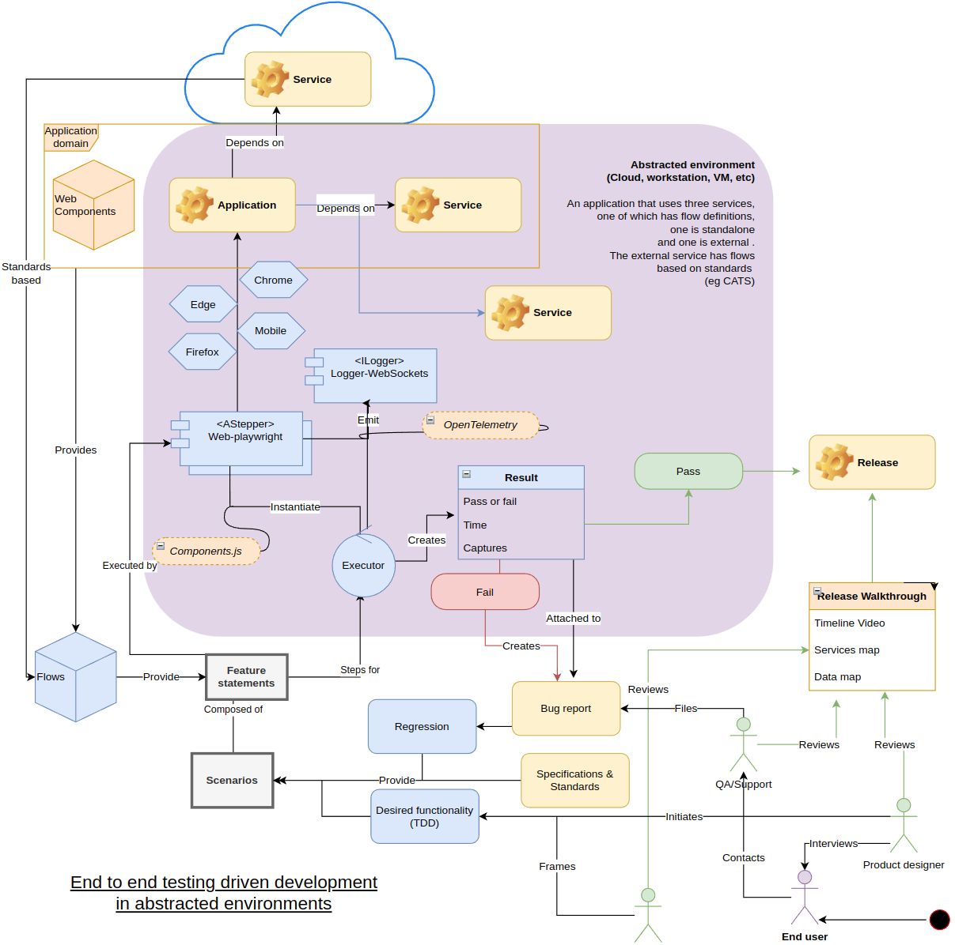
Haibun End to end test driven development in abstracted environments
Overview diagram

Slide 2
End to end testing Test the functionality and performance of an application under production circumstances (services, data, user environments) to replicate live settings. The goal is to simulate what a real user scenario looks like from start to finish.

Slide 3
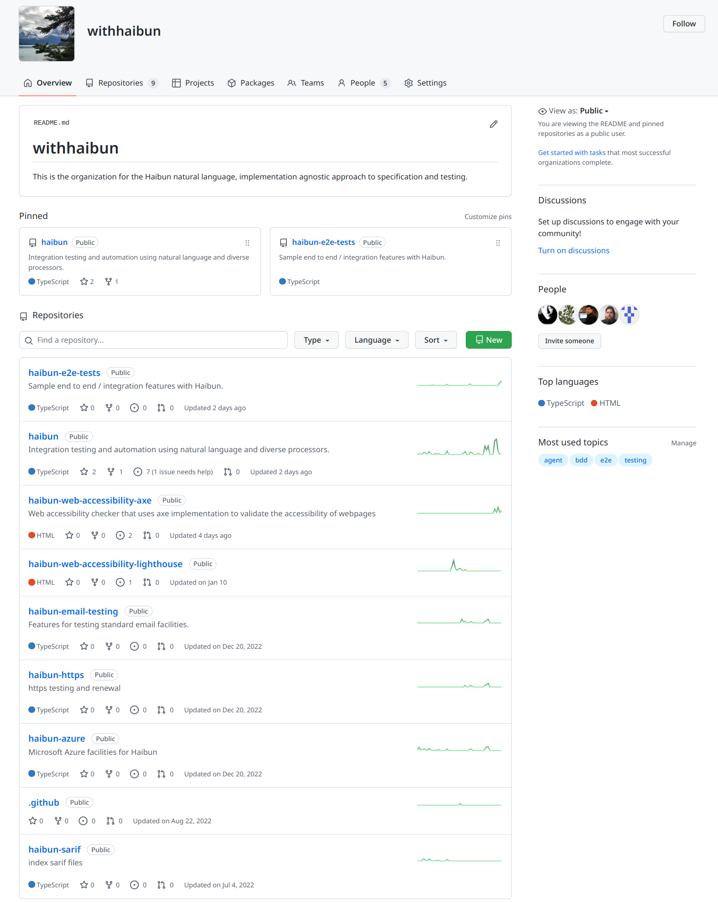
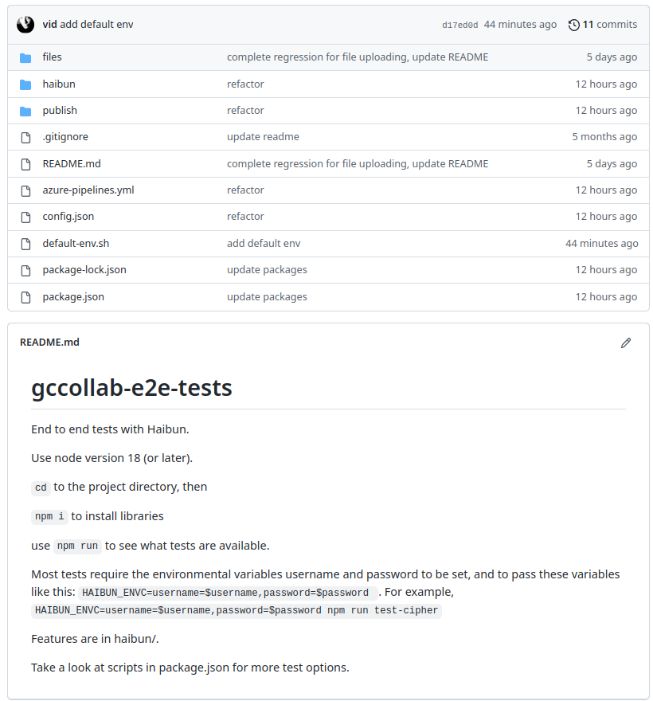
https://github.com/withhaibun
https://github.com/vid/gccollab-e2e-tests

Slide 4
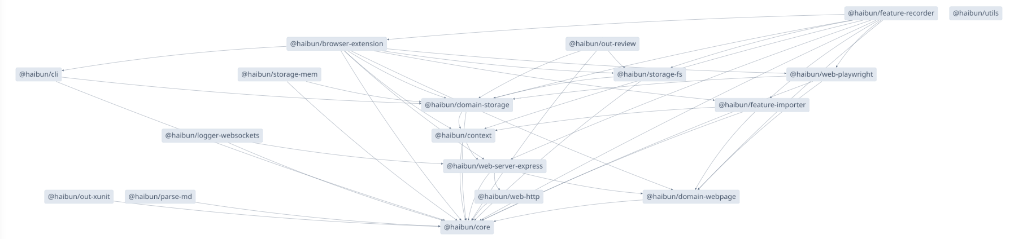
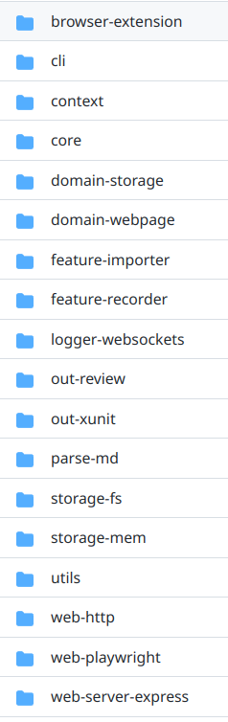
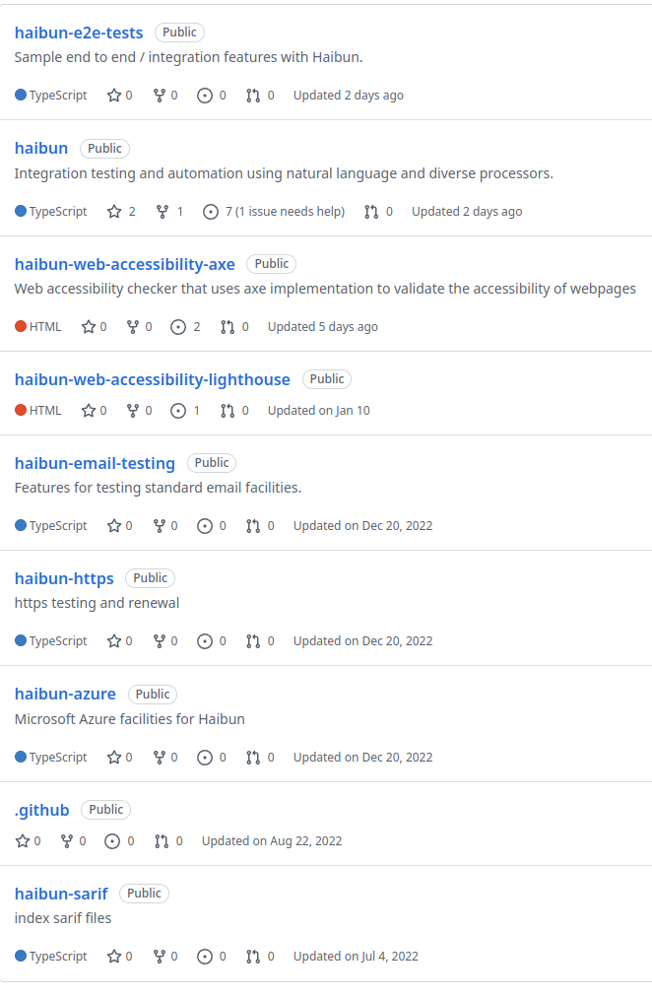
Module dependencies
Essential modules including abstractions; domains, storage implementations
Module ecosystem

Slide 5
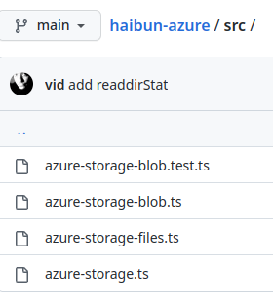
trigger:
- test-e2e
jobs:
- job: e2etests
pool:
vmImage: 'ubuntu-latest'
container:
image: mcr.microsoft.com/playwright:focal
volumes: [e2e-reviews]
steps:
- task: Npm@1
inputs:
command: 'install'
displayName: 'installing dependencies'
- task: CmdLine@2
displayName: 'Running login e2e tests'
continueOnError: true
inputs:
script: |
npm run
HAIBUN_TITLE="Login e2e tests" HAIBUN_DEST=e2e HAIBUN_O_OUTREVIEWS_TRACE_STORAGE=StorageFS HAIBUN_O_WEBPLAYWRIGHT_STORAGE=StorageFS HAIBUN_ENVC=${_ENVC} npm run test-pipeline-login
- task: CmdLine@2
displayName: 'Running regression e2e tests'
continueOnError: true
inputs:
script: |
HAIBUN_TITLE="Regression e2e tests" HAIBUN_DEST=regressions HAIBUN_O_OUTREVIEWS_TRACE_STORAGE=StorageFS HAIBUN_O_WEBPLAYWRIGHT_STORAGE=StorageFS HAIBUN_ENVC=${_ENVC} npm run test-pipeline-regressions
- task: CmdLine@2
displayName: 'Generate sarif indexes'
continueOnError: true
inputs:
script: |
HAIBUN_DEST=sarif HAIBUN_O_AZURESTORAGEBLOB_DESTINATION='staticanalysis-sc' HAIBUN_O_SARIF_TRACE_STORAGE=AzureStorageBlob HAIBUN_O_SARIF_INDEX_STORAGE=StorageFS HAIBUN_O_AZURESTORAGEBLOB_ACCOUNT=${_O_AZURESTORAGEBLOB_ACCOUNT} HAIBUN_O_AZURESTORAGEBLOB_KEY=${_O_AZURESTORAGEBLOB_KEY} npm run test-pipeline-index-sarif
- task: CmdLine@2
displayName: 'Generate test result indexes'
continueOnError: true
inputs:
script: |
HAIBUN_O_OUTREVIEWS_TRACE_STORAGE=StorageFS HAIBUN_O_OUTREVIEWS_PUBLISH_STORAGE=AzureStorageBlob HAIBUN_O_OUTREVIEWS_INDEX_STORAGE=StorageFS HAIBUN_O_OUTREVIEWS_REVIEWS_STORAGE=AzureStorageBlob HAIBUN_O_AZURESTORAGEBLOB_DESTINATION=e2e-reviews-sc HAIBUN_O_AZURESTORAGEBLOB_ACCOUNT=${_O_AZURESTORAGEBLOB_ACCOUNT} HAIBUN_O_AZURESTORAGEBLOB_KEY=${_O_AZURESTORAGEBLOB_KEY} HAIBUN_O_OUTREVIEWS_URI_ARGS=${_O_OUTREVIEWS_URI_ARGS} npm run test-pipeline-indexes
Storage implementation and pipeline for Azure (files & blobs). The pipeline uses the haibun-azure module, so Azure volumes can store artifacts with retention schemes per test or deployment type.

Slide 6

Implemented with minimum of dependencies
Highest fidelity for testing in each domain. Generate diagrams, videos, etc.
Application tests only contain the minimum versioned high level language, that could be understood by anyone.
Very high level of reusability between systems, reusable, versioned flows can be based on specifications, standards, components, applications
Scenarios as descriptions of swappable systems (identity provider, cloud, services, interface)
Very practical yet very wide potential scope
Seamless integration in best practice system
Based on very standard approaches (Playwright, Jest, Testing library), possible to “eject” basic standalone tests.

Slide 7
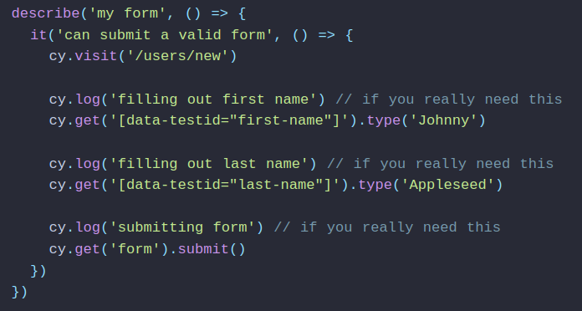
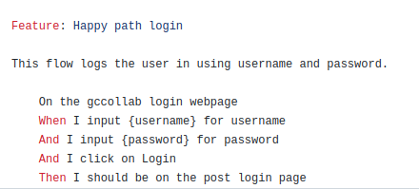
Cypress test
Completely tied to specific implementation (not abstract)
No consideration for connected services (not comprehensive)
Gobbledygook
Haibun test

Slide 8
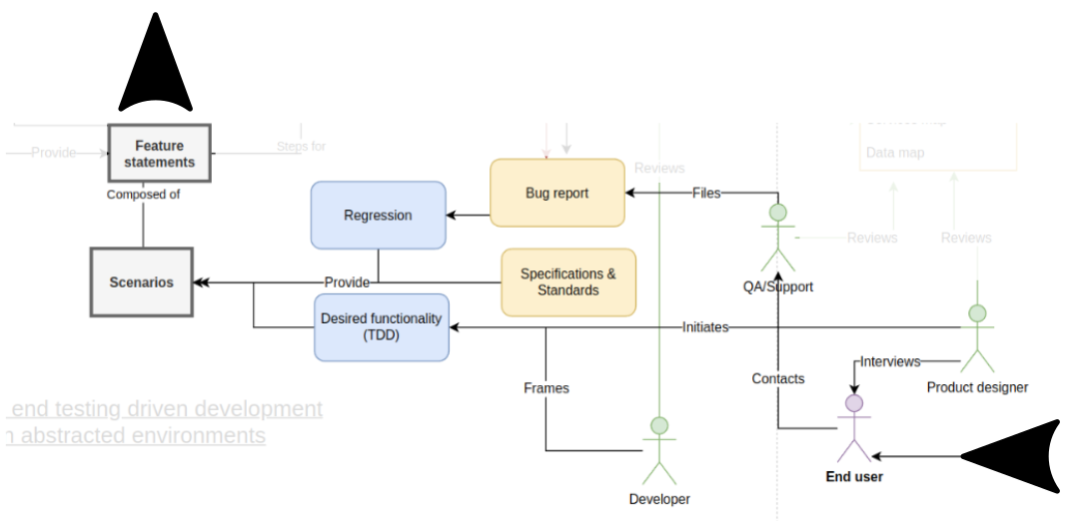
Workflow for specification test development

Slide 9
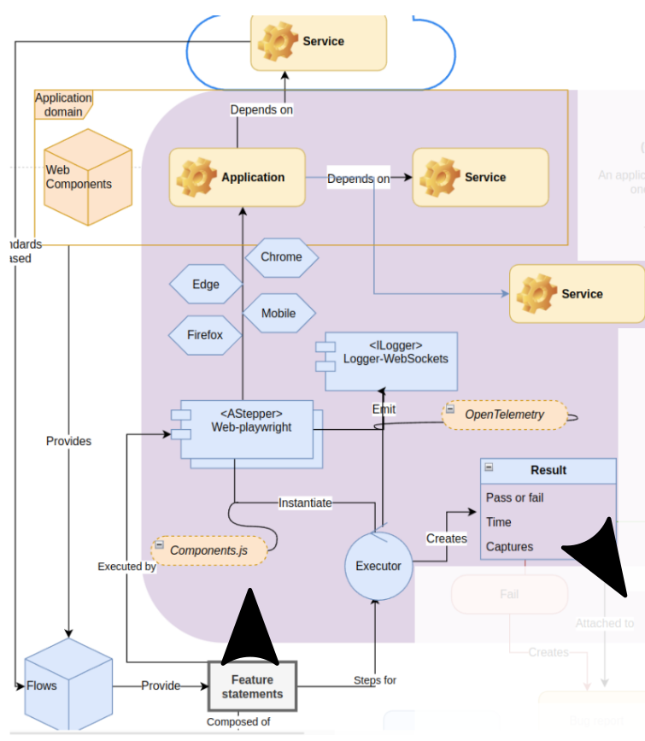
Abstract evaluation environment (cloud, workstation, VM, etc) using features & flows

Slide 10
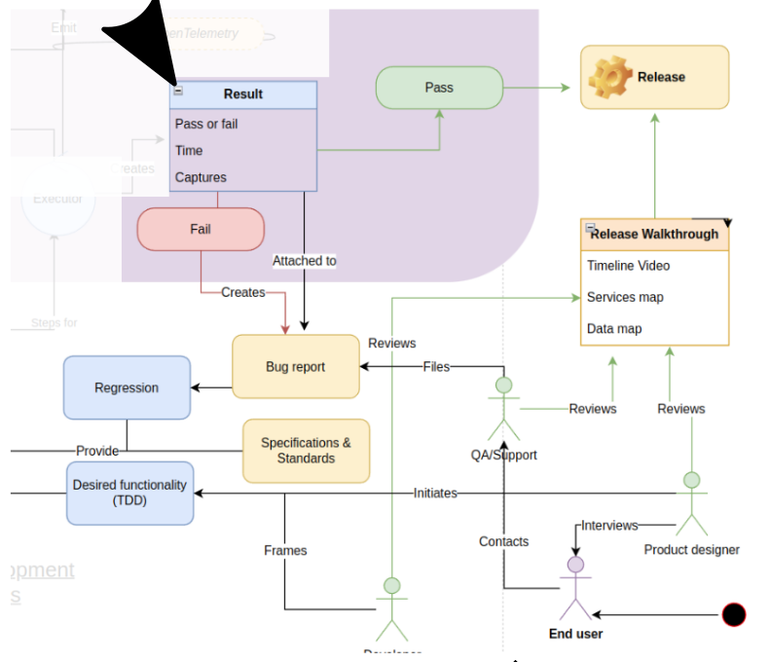
Results feeding back into workflow with deep, interactive artifacts

Slide 11
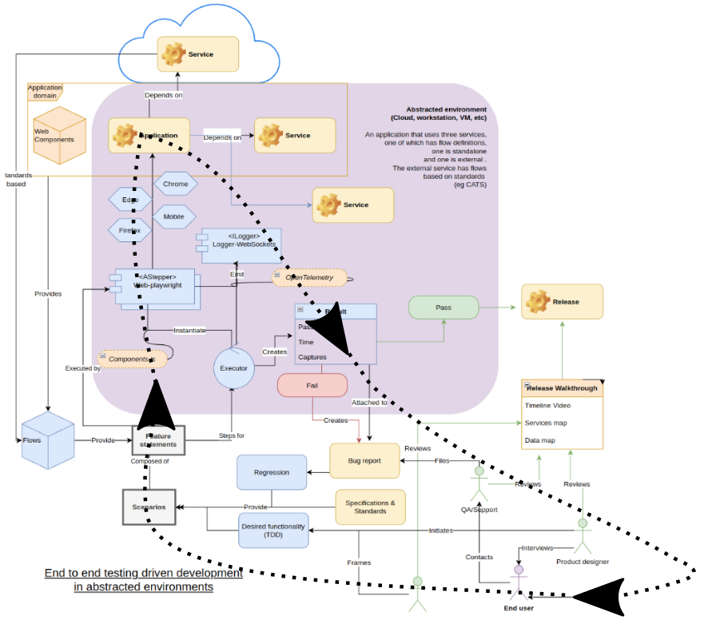
Agile user centred iterative inclusive built on best practices heterogeneous open source

Slide 12
From here
➡️Add mapping
Cipher pipeline
Use OpenTelemetry for messaging
Improve reviews
Alerts for unexpected service changes
“View source” (with versioning) of any statement
Adopt components.js for component model
Abstractly automate connection with Azure DevOps
Improve browser capture
Development pipeline
Developer and user ergonomics Editor helper
High fidelity load testing
Production pipeline
Save, resume, branch sessions
Automate security process and verification
Specification as test as documentation as data map as application generator (OpenAPI for services & components)

